Slide 1
Flywise - Week 4 Presentation
MSA 8030 Communicating with Data – Team 5
Tyler Trocchi, Jasmine Weekes, Jared Jones
November 12, 2024

Slide 2

Business Objective
Reduce unexpected delays
Streamline scheduling
Improve passenger travel experience
Minimize disruptions
Wants to enhance operational efficiency and elevate customer satisfaction by implementing a predictive model for flight departure times.
Notes:
Will strengthen its reputation as a reliable and customer-focused airline.

Slide 3
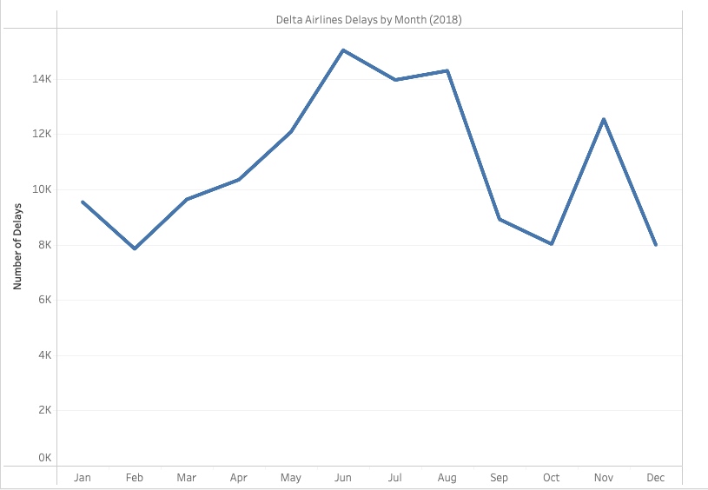
Delta Airlines Delays in 2018
Summer months have highest number of delays
Feb and Oct the lowest,
spike in Nov

Slide 4


Explored Use Cases
Use Case | Feasibility | Timeline | Resources | Constraints
Optimize Operations
Departure Forecasting
Cancellation Analysis
Customer Notification & Rebooking
Meets 4/4 criteria!
Notes:
Visual and verbal presentation align perfectly to elegantly and convincingly walk the audience through the use case selection process, how the use cases were prioritized based on criteria like feasibility, resource requirements, timelines, risks, and/or other constraints and argue effectively why the final use case was selected. The reasoning is persuasive and well designed to also convince non-technical business stakeholders.

Slide 5



Chosen Use Case
Departure Forecasting
A model to anticipate flight delays, enabling Delta to communicate accurate ETAs to customers and adjust resources if needed
Allows Delta to:
Proactively manage operations issues
Reduce costs
Improve customer satisfaction.
Meets Business Goals
High Impact
High Feasibility
Notes:
High impact, feasible implementation, aligns with business objective

Slide 6
Business to Data Science
How are we going to implement this use case?
Method: Design a neural network model with a target variable to minimize differences between anticipated and actual departure time.
Benefits: Handles large datasets well, adaptable to sequential data (time series), high accuracy and high flexibility in terms of types of data

Slide 7
Set Analytics Goals and Scope Solution
Milestones
How do we identify which flights will be delayed and for how long?
What differentiates delayed and non-delayed flights?
What criteria/process will be used to reallocate resources and reschedule flights
Metrics
Reduce total customer time lost due to delays and cancelled flights
Reduce amount of money lost due to delays and cancelled flights (rebooking, customer compensation, bad reviews)
Reduce length of time airport terminal is operating at or above capacity

